Slide 1
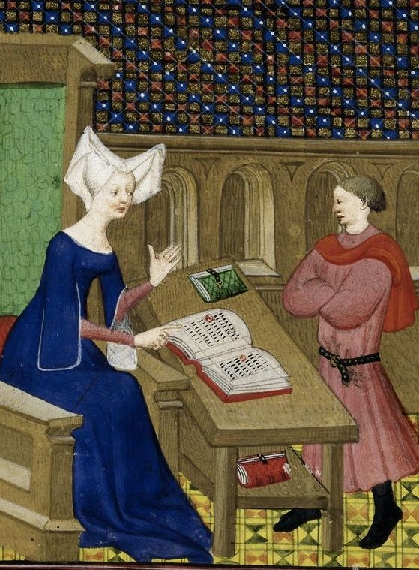
15K
15 Minutes of History
with Kajmeister
Notes:
Hi folks, kajmeister here. Welcome to my presentation, 15 minutes on a historical topic with me, Maria Kaj. Hence the name 15K.
These are less narratives of history and more ways to think about history, historical ideas, historical arguments, historical perspectives.
Shorter than a podcast, but longer than a blog. Let’s get started!

Slide 2
Nevertheless, She Persisted or Look! There’s Proof! Medieval Women & Wealth
Maria Kaj, MA Hist ‘23
Notes:
Today’s topic is Medieval Women and Wealth.
I’ve subtitled this “Nevertheless she persisted” because we’re going to talk about some of the barriers women in the Middle Ages had in handling wealth.
I’ve also titled this “Look, there’s proof” because some of the barriers may surprise you…

Slide 3
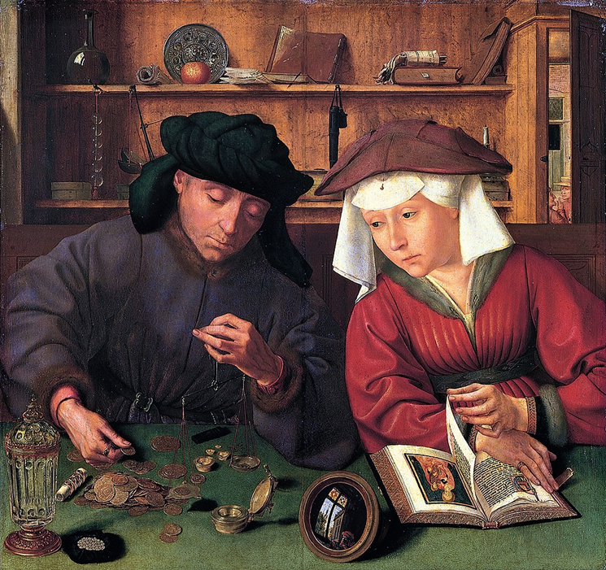
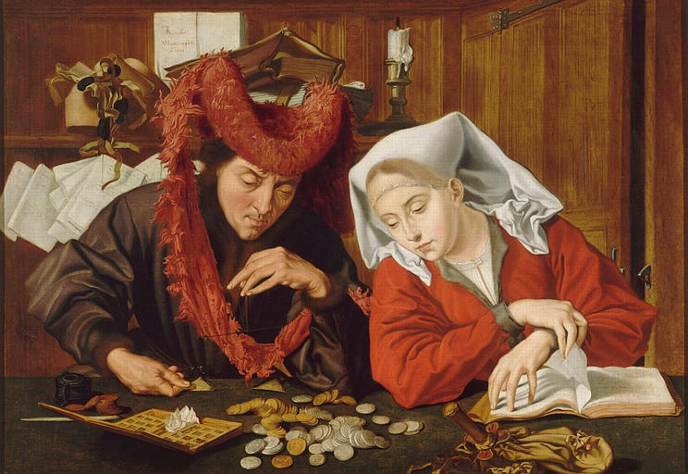
“The moneychanger and his wife,” Quentin Metsys, 1514 (The Louvre)
“The Moneychanger and his Wife,” Marinus van Reymerswaele, 1538 (Musée des Beaux-Arts de Nantes)

Slide 4
Key Questions
What were the barriers that medieval women faced in handling financial affairs?
How did medieval women overcome barriers in order to manage financial affairs?
Royals? Marital Status? What kind of evidence?
SCOPE: Northern Europe, 1200-1500
Questions Historiography
Primo- geniture
Feme covert
Avarice
Visibility
Notes:
So that leads to key questions for this research: What were the barriers that medieval women faced? How did they overcome those barriers?
Did it matter who they were – whether they were noble or not? Did it matter whether they were married or single?
And what kind of evidence do we have? We don’t want to guess. Interpreting a painting is a little bit of guesswork, since the painters didn’t say. What does the data tell us?
Lastly – Scope – this will focus on Northern Europe in the late Middle Ages, 1200-1500…. Before the Renaissance, before the Colonial era, after the ancient world. And also, not in Asia, Africa, or the Middle East – which all had their own cultures and depictions of women, too.
Now there are three main types of barriers we’re going to discuss: Primogeniture, Feme Covert, and Avarice – I’ll explain all those in a minute.
But first, let’s talk about an implicit barrier.

Slide 5
Historians Say…
“By the close of the Middle Ages, one social axiom had become firmly established and was long to remain in force: ‘Woman’s voice is not to be heard in public’…” (Heer)
“Very little evidence has survived on credit transactions in the so-called the ‘Dark Ages’ … complex credit instruments were too sophisticated until the Renaissance…” (Jordan)
History had no Women
Women were oppressed
Let’s focus on poor Women
What is gender anyway?
There’s no data on women
Women DID manage wealth!
Questions Historiography
Notes:
Now, when we talk about history there’s a big word: HISTORIOGRAPHY, which means what other historians said. It turns out that there hasn’t been all that much written on women and money in the Middle Ages, whereas you can quite a few books on say The Hundred Years War. Here’s what happened.
At first, historians didn’t write about women because they focused on political leaders or the military. Or they wrote about them only as oppressed – Fr. Heer writes a chapter on Jews & Women.
Feminists focused on women at last, but only on the poor or argued about what gender was in postmodernism, OR said they just couldn’t get data.
Only since about 2015 have there been real concrete studies, 600 years later and only in the last decade… so we’ll talk about them.

Slide 6
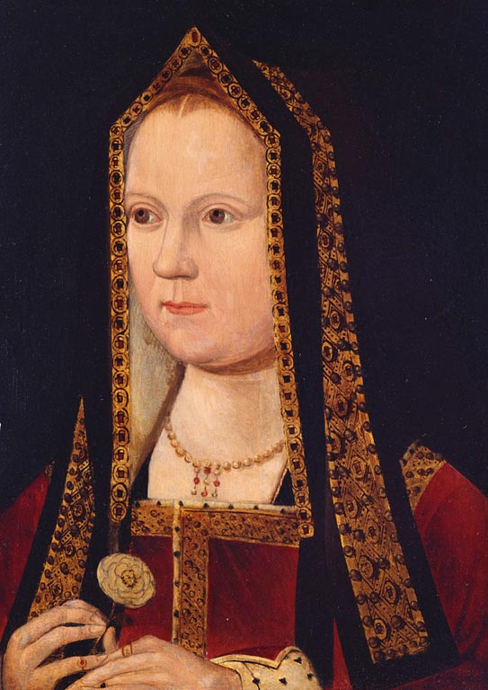
Can’t Inherit
PRIMOGENITURE
Eldest son inherits
Philip VI (1350) sons died w/o sons; France tightened the rules
Elizabeth of York: daughter, sister, niece, mother, wife … never Queen
Primo- geniture
Notes:
Let’s talk about the first one – another big word PRIMOGENITURE That meant the title, estate, kingdom, whatever passed to the eldest male relative--The son, the brother, the nephews – girls, again in Northern Europe, can’t inherit the main estate.
In some countries, that caused difficulties when sons died young, as the sons of Philip VI did. But instead of turning to women as potential queens, France tightened the rules, even disallowing the sons of the daughters to inherit the kingdom.
Or consider Eliz of York pictured here 1480, eldest child of Edward IV, was the daughter, sister, niece, wife and mother of kings – but never had a chance to be queen. Instead, her younger teenage brother was made king and locked in a tower and never seen again. Civil War might have been avoided… plus, If you can’t inherit the big enchilada, how are you going to manage the estate?
The answer is, just because they can’t inherit, doesn’t mean they can’t do the work!

Slide 7
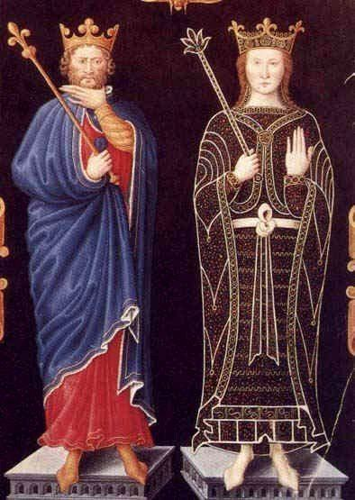
Can Manage
opportunities
Philip VI: Need “sensible management” … so Joan was regent
Queens managed own lands, as seen in the patent & title rolls
Accused of
Too kind & gentle or … capricious, physically weak, lustful, unstable, lack of intelligence, irrational…
…but they were frequently regents
Primo- geniture
Notes:
So Philip VI of France– his wife Joan of Burgundy was queen consort, not queen in her own right, but he still put her in charge when he left to fight on campaigns or negotiate treaties, which was frequently. He said “we need sensible management” and she’s the one!
Queens could be regents, handling taxes, income, royal budgets, andf they made dynastic marriages for their children
Or another recent, Michelle Seah and Katia Wright found queens significantly involved managing land that they brought in with their dowries. They noted that you couldn’t look in the exchequer, because that had only had the king’s stuff, but data was there in patent title rolls or queen’s estates. Queens very involved with financial management of their own property.
Even though queens were portrayed as unsuitable as managers. They are kind – too kind to tax properly, can’t have that. Or called capricious, weak, lustful, unstable, dumb, irrational… The men at court wrote that women were untrustworthy in general, even while they praised individual women that they personally knew and they were given vast responsibility as regents. That might sound familiar to some.

Slide 8
Man & Wife are One
FEME COVERT
Husband had legal control over wife’s property
“Feme sole” required husband permission & rare in M. Ages
However, Daughters often educated to be good wives, i.e. to do the books
Feme covert
Notes:
What if you weren’t royal, just an ordinary merchant like our moneychanger here.
There was a legal doctrine: called FEME COVERT. Feme covert originated with the French, migrated to England and became entrenched in the medieval English legal code. Iff you studied colonial history in America, you might have heard of it – it was still in force.
Feme covert means that the husband and wife are one, her property came through the dowry into the marriage, and then he is in charge of it.
Now there was such a thing as “feme sole” which was where a woman could operate a business independently, but she needed her husband’s permission. Modern scholars always want to talk about this, but medievalists think there were very few of these in place, so not really a big deal.
This means husband had control over what happened to property – he couldn’t sell it without her permission, but it was control nonetheless. Now, just because the husband had control didn’t mean women did nothing. Women often were educated precisely because it made them good marriage partners and bookkeepers. One study also suggested that married women might fare better in a property dispute than daughters. So what if you were someone’s wife and someone’s daughter? Complicated.

Slide 9
Uncovered
Unmarried
Widows & Nuns (“tearful orchestra”)
Single women
The Poor Clares of Nuremberg…
25% of Genoese municipal investment women/widows
15% of annuity contracts; 70% in Leuven widows, BUT 60% in booming economy of Antwerp were single
Feme covert
Notes:
Moreover, what if you weren’t married? Not everyone was. There were definitely groups of women who could invest independently– like widows and nuns, not covered by feme covert and not covered by their parents anymore.
Widows and nuns (and orphans) were sometimes called the “tearful orchestra” because, being husbandless, they were “alone” in the world. So, for example, they were able to make loans and charge the occasional interest, even though generally there was a ban on charging interest, calling it usury.
So that’s where one scholar, William Jordan found women involved in the capital market. The Poor Clares for example, were active in mortgages and annuities ( an annuity is a contract you buy that gives you a fixed payment). Jordan also found a high percentage of municipal investment in Genoa was by women and a chunk of that widows.
Meanwhile, another Scholar Andrea Bardyn even showed that in the hot economic market like Antwerp, a huge chunk of investors weren’t even widows but single women who had come to the city off the farm to earn their fortune and had enough wages to invest.

Slide 10
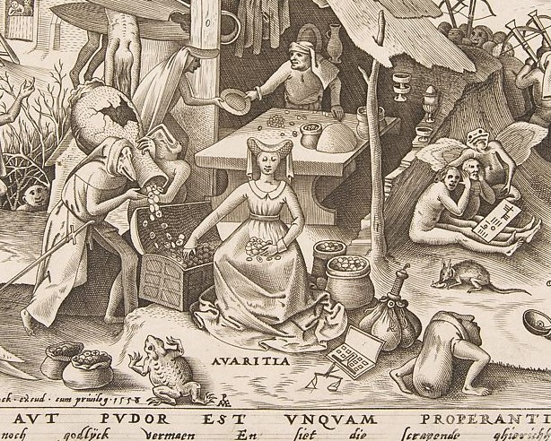
Avarice
Deadly sin
“Money was seen as an instrument of exchange that had devil-like, magical powers of luring people and then of corrupting them…” (Little)
Delilah, Jezebel, Eve
Avarice
Notes:
So maybe there were ways around inheritance rules and the husband/wife rules, the feme covert. But the Church itself still had a big say in what anyone could do. And they had this idea about Avarice. Avarice is another fancy word – it just means Greed. It was one of the Seven Deadly Sins, which you might have heard of .. Lust, Sloth, Gluttony and so on.
If a farmer sold a cow, supposedly he couldn’t a profit. You couldn’t loan someone 20 and get back to 25 – that was getting something for nothing. (except for the tearful orchestra mentioned earlier) Ultimately, coins/money themselves was seen as corrupt. So here, in this satire by Breughel, -- and this is a satire, there are clearly fanciful figures here – you have toads and demons surrounding the money handlers. And a woman is front and center.
Women in particular were associated with avarice… priests would rail against the Biblical villainesses who were greedy. The big ones were Delilah, Jezebel, and especially Eve. And they extended this to real people, so…

Slide 11
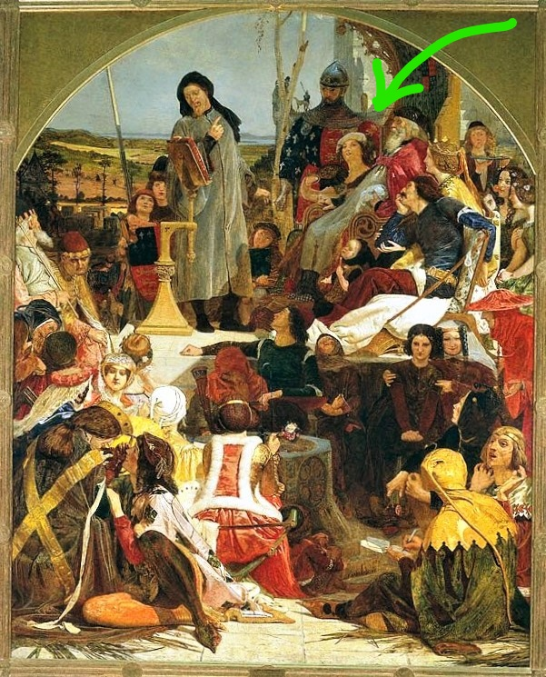
Gold-Diggers= Avarice + Lust
ALICE PERRERS
Helped Edward III with financial advice
Gained wealth/property as a courtier
“ shameless lowborn meretrix –” Thomas Walsingham
Avarice
Notes:
Let’s say you’re a business-savvy woman with connections to court. You’re a handmaiden to a queen, but much prettier and the king takes a fancy to you, which is great when the queen dies. This is how Alice Perrers became the mistress of Edward III. Here she is depicted with Edward, as the court listens to Geoffrey Chaucer, she’s up there on the right…
She’s a shrewd woman and she uses her court connections to get Edward to give her land and jewels, but she also consults with him, advising him on in his financial affairs, such as helping him negotiate some of the large loans he used to finance his expensive war with France.
If you think about it, Lots of men got close to kings – Thomas Cromwell with Henry VIII, Charles I de Montmorency with Philip VI. They get biographies written about them as powerful advisors.
But Alice Perrers is called a schemer. She and several courtier friends are impeached, i.e. pushed out of court. She wiggles her way back in, after managing to talk with Edward, but when he dies, she again is banished and all her wealth confiscated. But not just that – historian Thomas Walsingham called her “ a shameless lowborn meretrix (a word translated as mistress, whore, or harlot).”
And that carries through – even in our times historians like Barbara Tuchman and Dan Jones, who both wrote these giant tomes about the middle ages call her “vulgar” and “unscrupulous.”
The big label: Gold Digger, a combination of two sins, avarice and lust.

Slide 12
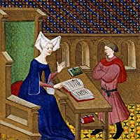
Piety to the Rescue!
CHRISTINE DE PISAN
“the wise princess will look after her revenue and expenditure…”
“persuade her husband by kind words and sensible admonitions to discuss their finances together”
“be knowledgeable of fiefs, sub-fiefs, quit rents, champarts, taxes…”
“deserve your wealth from God by giving to the poor”
Accounting becomes virtuous labor. (Miley & Read)
Avarice
Notes:
How do women get around avarice? Piety! Excessive piety –
The solution is proposed by none other than Christine de Pisan, a romance and courtly love writer of 15th c. She’s very known to medievalists because she was the first European woman known to have lived off her writing. She also wrote books of advice, most notably one called the Treasure of the City of the Ladies. And in it, aside from giving advance on fashion, courtly behavior and how to have a good marriage, she talks about financial matters…. Miss Manners, Marie Kondo, and Suze Orman all rolled into one, well, plus on the Trinity Broadcasting Network, right? Because it’s religious themed and she talks about piety and God on every page.
She talks a lot about the wise princess … looking at her books, working with her husband, becoming knowledgeable about the different types of income. And she explains that being a good steward of your wealth is okay because your job is to give it away. When you support charities—especially religious charities—then it’s your duty to get up early and study crop rotations.
Thus, accounting becomes virtuous labor.

Slide 13
Constraints, but Opportunities
Primogeniture
Feme Covert
Avarice
Regents or manage dower property
Widows, nuns, unmarried handled $$
Wives helped husbands
Piety + good $$ stewardship= okay
The art historians, not the artists?
Notes:
So let’s summarize. There were constraints, there were also opportunities, which became really clear once they dug into the data..
So what about these paintings, these portrayals of greed and warnings of avarice?
Remember? Portrayal of greed?
One art historian, Manuel Santos Redondo, did an analysis of the Metsys and Van Reymerswaele paintings and their evaluations in the 16th century versus in the 21st century. And he comes to the distinct conclusions that at the time, these were considered only slice of life of paintings, simple depictions of people at work.
There is symbolism in the painting but not necessarily a warning against greed – Redondo says that’s modern.
He argues that the art historians are biased. That art historians themselves think money is vulgar, so they’re projecting their opinions on to the painting.

Slide 14
Look, Here’s Proof!
BUT THERE IS EVIDENCE!
“Very little evidence has survived on credit transactions in the so-called the ‘Dark Ages’ … complex credit instruments were too sophisticated until the Renaissance…” (Jordan)
Aldermen’s records in Low Countries (registered contracts)
Municipal mortgage contracts
Patent, Tax, Lien rolls
Queen Estate Archives
Absence of Evidence <> Evidence of Absence
Visibility
Notes:
Also it turned out there’s quite a bit of information we can dig into over women and wealth in the middle ages, between the queens, dowries, and stewardship for the wise princess. Remember that some scholars said there just wasn’t any evidence… but these studies in the last dozen years are finding plenty of data in aldermen’s records, in mortgage contracts, patent rolls, and the estate archives of the wealthy and the royals.
Here’s in a way another REAL PROBLEM: there was a historian’s belief that you couldn’t get data
Absence of data then turned into a belief that these barriers were just too much for women to overcome

Slide 15
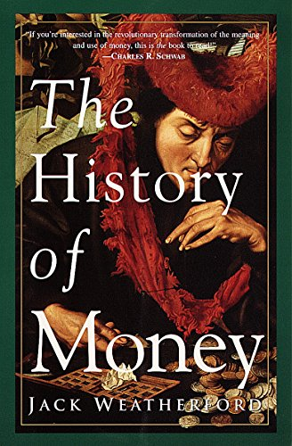
Visibility Issue is Us
Viewpoint that medieval women did not manage money is also a modern one
A Historian problem, not necessarily a historical problem
Notes:
Well, if people can project opinions on to paintings, what else can they do? For six hundred years, people thought women couldn’t participate in handling money, despite a lot of evidence that we have now that they did. But only dated 2020.
So let me end with a book cover from a 1997 book on the History of Money. Book covers are chosen by the publisher, not the authors, and there are women handling money occasionally in this book by Jack Weatherford.
But what happened to the woman and the dilemma – is she doing the books or distracted from devotions? The problem is solved. She’s cut out entirely.
The problem may not be how women were treated in the Middle Ages… the problem may be in the mirror. So maybe this is the call to action: Let’s go dig some more into those aldermen’s records and queenly estate archives! And let’s put the woman back in the picture when we talk about the history of money.

Slide 16
Tell Me More…
Bardyn, Andrea. “Constrained Opportunities: Women’s Involvement in the Capital Markets of Late Medieval Brabant.” Social History (London) 45, no. 3 (2020): 275–303.
Christine, de Pisan. The Treasure of the City of Ladies: Or, The Book of the Three Virtues. Translated by Sarah Lawson. Revised edition. Penguin Classics. London: Penguin Books, 2003.
Jordan, William Chester. Women and Credit in Pre-Industrial and Developing Societies. University of Pennsylvania Press, 1993. https://www.jstor.org/stable/j.ctv5131h8.
Leyser, Henrietta. Medieval Women: A Social History of Women in England, 450-1500. First edition. New York: St. Martin’s Press, 1995.
Miley, Frances, and Andrew Read. “Choreography of the Past: Accounting and the Writing of Christine de Pizan.” Accounting Historians Journal 44, no. 1 (June 1, 2017): 51–62. Parsons, John Carmi, ed. Medieval Queenship. New York: St. Martins Press, 1993.
Santos-Redondo, Manuel. “The Moneychanger and His Wife: From Scholastics to Accounting,” January 2, 2008.
Sarti, Cathleen, ed. Women and Economic Power in Premodern Royal Courts. Arc Humanities Press, 2020. https://doi.org/10.2307/j.ctv15vwk79.
Weir, Alison. Elizabeth of York: A Tudor Queen and Her World. New York: Ballantine Books, 2013.
Woodall, Joanna. “‘De Wisselaer’: Quentin Matsys’s ‘Man Weighing Gold Coins and His Wife,’ 1514.” Nederlands Kunsthistorisch Jaarboek (NKJ) / Netherlands Yearbook for History of Art 64 (2014): 38–75.
Notes:
Even though great information is still in a fledgling stage here, there have been some excellent histories done on this topic.
To find key primary sources (that’s history-speak for what they wrote back in the day) are Christine de Pisan and in Alison Weir’s biography of Elizabeth of York.
You can also find excellent analysis and statistical results in these other books – the Bibliography!

Slide 17
Picture Credits
Fig 1: Bedford Master, “Christine de Pisan instructs her son, Jean de Castel,” 1413, Collected Works of Christine de Pisan. https://commons.wikimedia.org/wiki/File:Christine_de_Pisan_and_her_son.jpg
Fig 2: Quentin Metsys, “The moneychanger (money lender) and his wife,” 1514, The Louvre. https://commons.wikimedia.org/wiki/File:Massysm_Quentin_%E2%80%94_The_Moneylender_and_his_Wife_%E2%80%94_1514.jpg
Fig 3: Marinus van Reymerswaele, “The moneychanger (money lender) and his wife,” 1538, Musée des Beaux-Arts de Nantes. https://commons.wikimedia.org/wiki/File:Marinus_van_Reymerswale_007.jpg
Fig. 4: British School (unidentified), “Elizabeth of York,” 1470, Hampton Court Palace. https://commons.wikimedia.org/wiki/File:British_School,_16th_century_-_Elizabeth_of_York_-_Haunted_Gallery,_Hampton_Court_Palace.jpg
Fig. 5: Jean du Tillet, “The king Chilperic, son of Chlothar the first and the queen Fredegonde, his wife,” @1570, Bibliotheque nationale du France. https://commons.wikimedia.org/wiki/File:CHILPERIC_1er_ET_FREDEGONDE.jpg
Fig 6. Unidentified, “Medieval Widowhood,” image from Medievalists.net. https://www.medievalists.net/2014/03/alice-de-lacy-hazards-possibilities-medieval-widowhood-1322-1348/
Fig.7: Peter Bruegel the Elder, “Avarice (Avaritia) from The Seven Deadly Sins,”1558, Metropolitan Museum of Art. https://www.metmuseum.org/art/collection/search/383074
Fig 8: Ford Madox Brown, “Chaucer at the court of Edward III,” 1851, Tate. https://www.tate.org.uk/art/artworks/brown-chaucer-at-the-court-of-edward-iii-n02063
Fig 9: Cover photo, part of “The moneychanger and wife,” The History of Money, 1997, NY: Three Rivers Publishing. (Author photo of book).
Notes:
Even though great information is still in a fledgling stage here, there have been some excellent histories done on this topic.
To find key primary sources (that’s history-speak for what they wrote back in the day) are Christine de Pisan and in Alison Weir’s biography of Elizabeth of York.
You can also find excellent analysis and statistical results in these other books – the Bibliography!

Slide 18
Copies of this presentation and more information can be found on:
Kajmeister.com
15K
Thank you!
Notes:
If you want to get a copy of this presentation or more information, it’s all on the website…. Kajmeister.com
Thanks for watching!

